Slide 1

Boston Survival Guide
Alvaro Chinchayan, Leighton Li, Andrey Lifar, Yoki Liu, Sherry Zuo

Slide 2

Table Of Contents
Overview
Time Analysis
Location Analysis
Crime Attribute Analysis
Multivariate Analysis
Limitation
Business Plan
Summary

Slide 3
Overview
Our team is interested in crimes that were reported in the Boston area (including 11 districts) from June 2015 to October 2018.
The main purpose of our project is to analyze patterns of crimes, the potential incentives for crimes, as well as how other factors such as housing prices, income correlate with crimes.

Slide 4
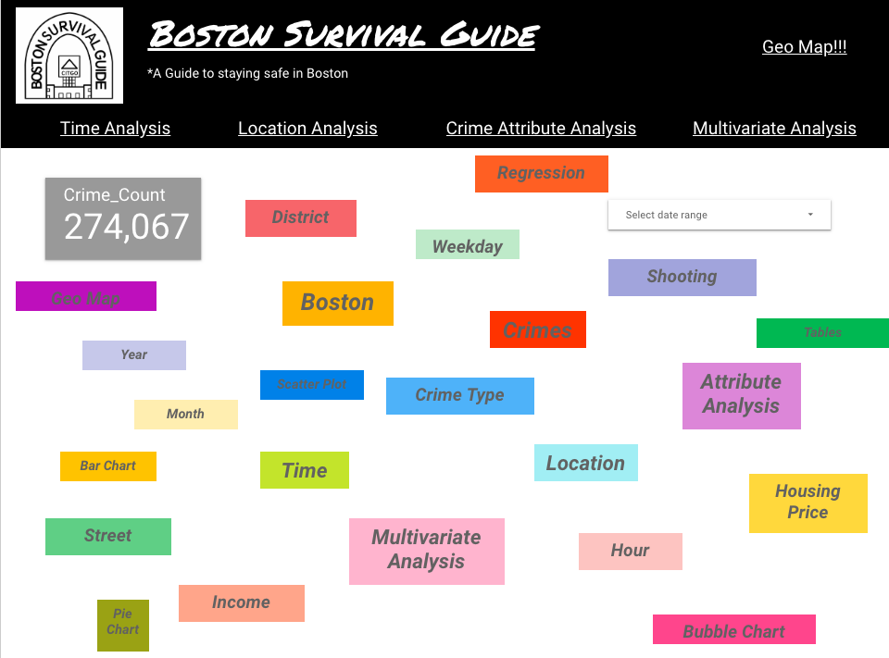
Notes:
https://datastudio.google.com/open/1GCwkYrQMg6IZx3y7T_DKf4ZxcF8dPgWH

Slide 5
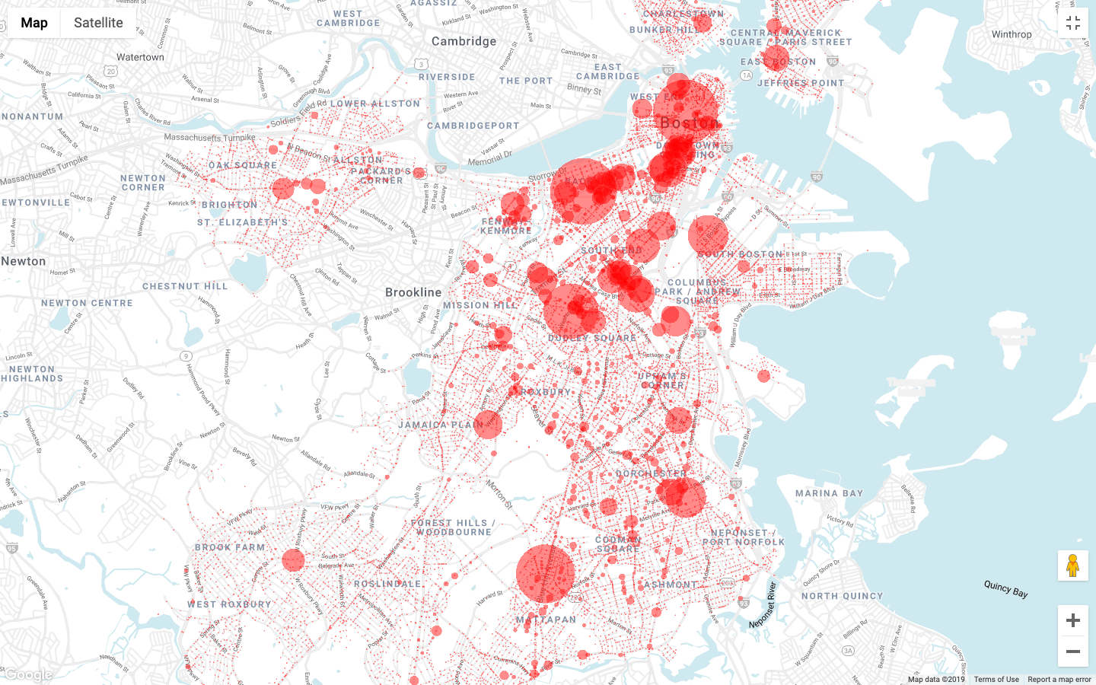
Notes:
https://cloud.google.com/bigquery/docs/gis-getting-started
https://bigquerygeoviz.appspot.com/
Query:
SELECT
ST_GeogPoint(longitude, latitude) AS WKT,
count(District) as num_crime
FROM
`team-6-is-perfect.Boston_Crime.boston2`
Group By longitude, latitude
Data:
WKT
Style:
fillOpacity:
Value: 0.5
circleRadius:
Function: linear
Field: num_crime
Domain: 30-60
Range: 5-20

Slide 6
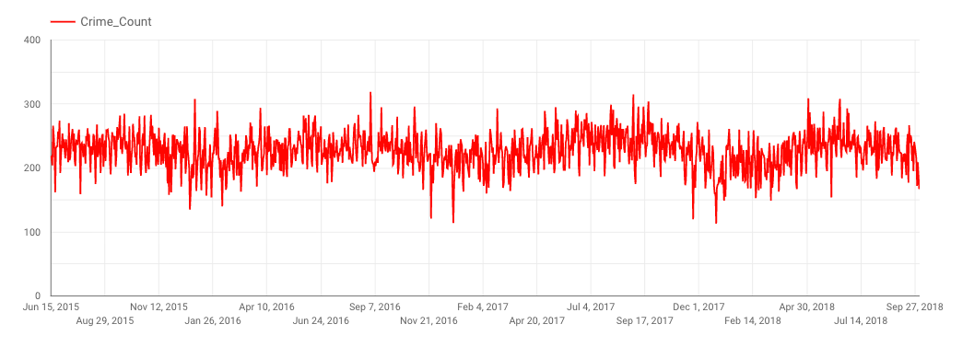
Time Analysis -- Time Series

Slide 7
Time Analysis -- Year & Month
Year | Number of crimes
2017 | 100 938
2016 | 99 134
2018 | 74 356
2015 | 53 392
Month | Number of crimes
August | 35 137
July | 34 640
September | 34 023
June | 30 622
Overall increase in the number of crimes throughout the US in 2015-2017
Officials doing their best to prevent new crimes
All the students come back to school in July and August (new international students)
Some studies claim that warmer weather has positive impact on the number of crimes

Slide 8
Time Analysis -- Weekday & Hour
Day of the week | Number of crimes
Friday | 43 751
Wednesday | 42 750
Thursday | 42 547
Tuesday | 42 340
Monday | 41 704
Saturday | 40 360
Sunday | 36 234
Time of the day | Number of crimes
5 pm | 21 350
6 pm | 20 908
4 pm | 20 373
12 pm | 19 198
7 pm | 18 055
People tend to relax after work/school on Fridays and become less vigilant
Many celebrations during the week are postponed to Fridays and people tend to be home on Saturdays and especially Sundays
Most crimes take place between 4 and 7 pm (when people finish working/studying)
12 pm - lunch time (out of work/school)

Slide 9
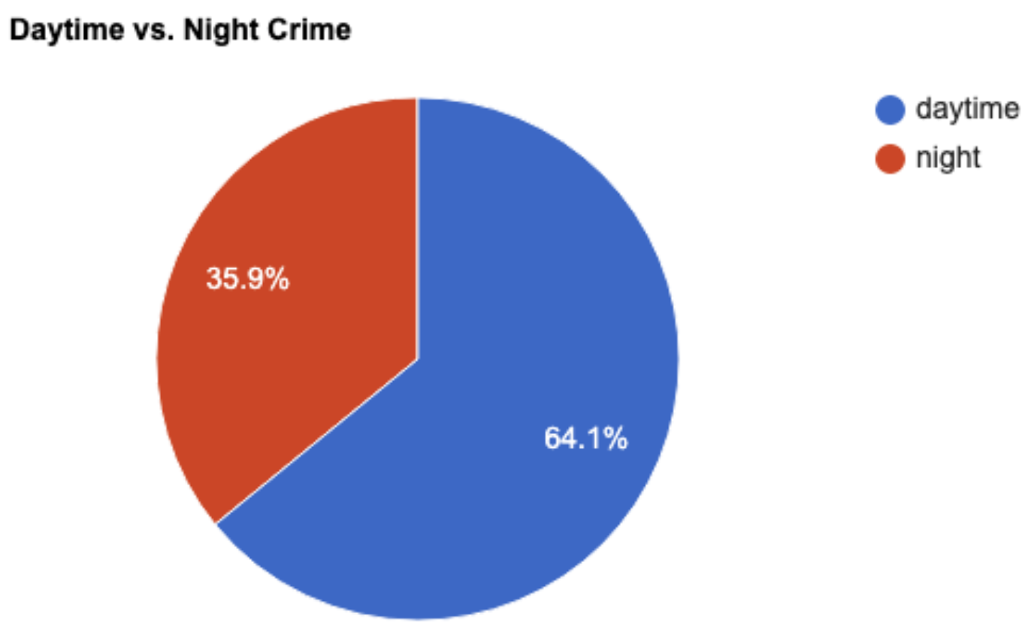
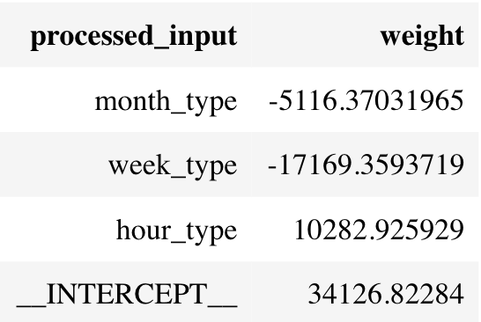
Time Analysis -- Day vs Night and Regression
Daytime: 6 am - 6 pm
Three dummies for the regression analysis:
1. Month type
2. Day of the week type
3. Time of the day
R-squared = 0.869

Slide 10
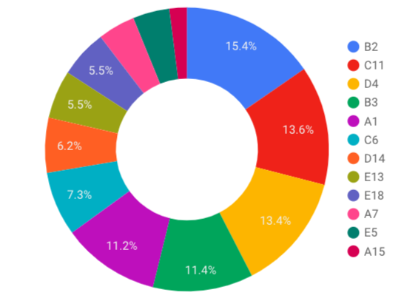
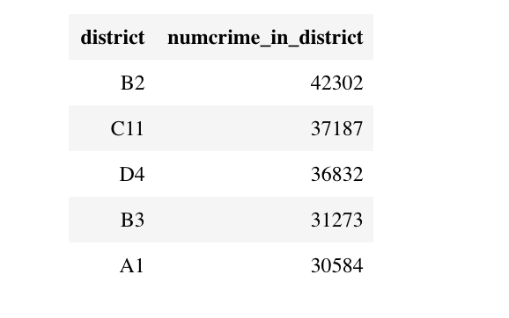
Locate Crimes -- Neighborhoods
B2 Roxbury
C11 Dorchester
D4 South End
B3 Mattapan
A1 Downtown
(From June 2015 to October 2018)

Slide 11
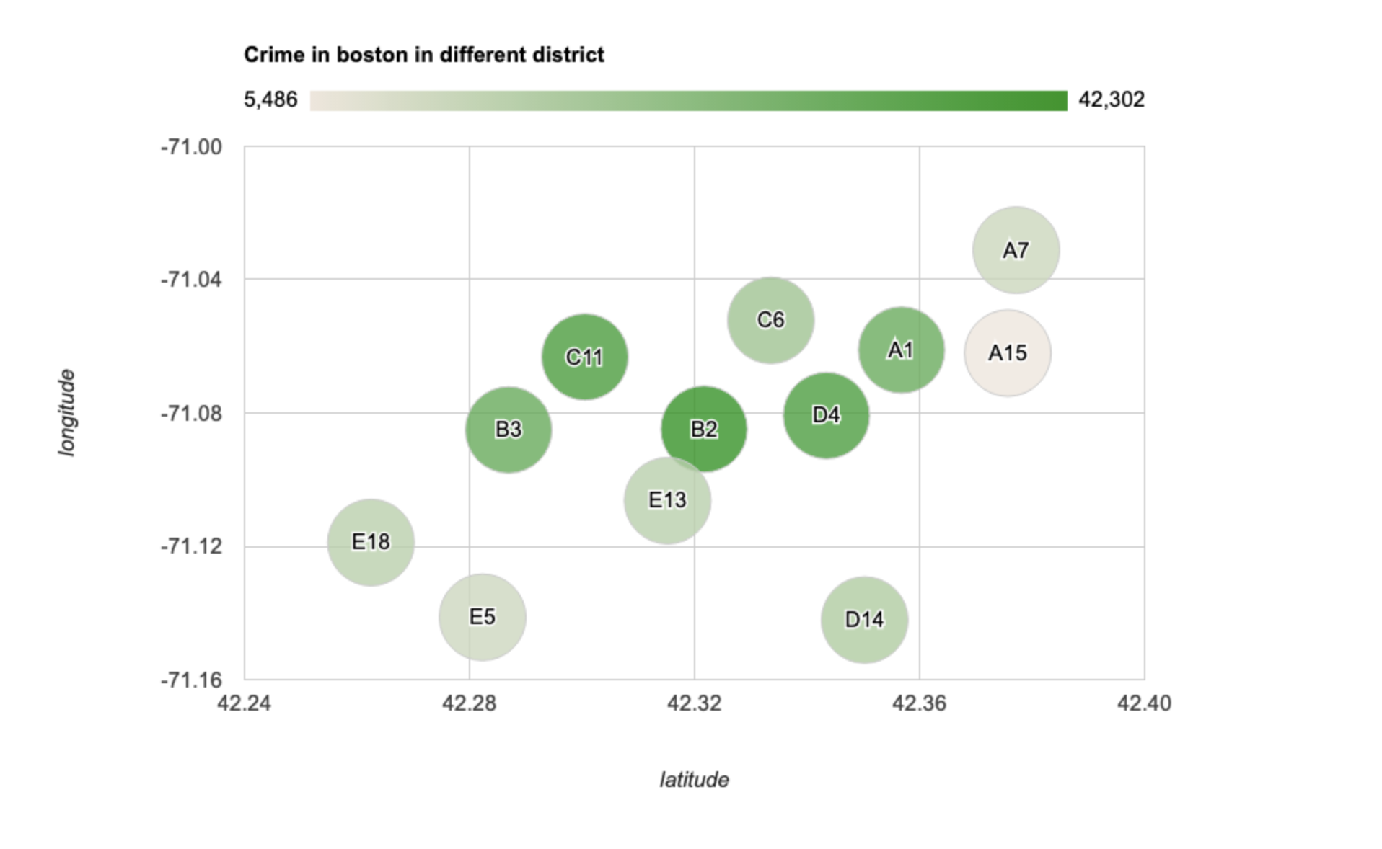
Locate Crimes -- Bubble Chart
Charlestown

Slide 12
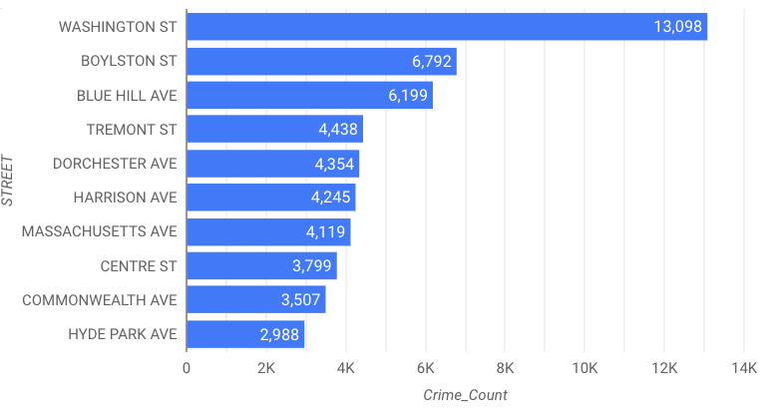
Locate Crimes -- Streets
Washington St. -- the longest street in Boston.
Boylston St. -- a major commercial artery.
Blue Hill Ave. -- connects Roxbury, Dorchester, and Mattapan.
Tremont St. -- from downtown to Roxbury.
Dorchester Ave. -- from downtown to Ashmont/Mattapan.

Slide 13
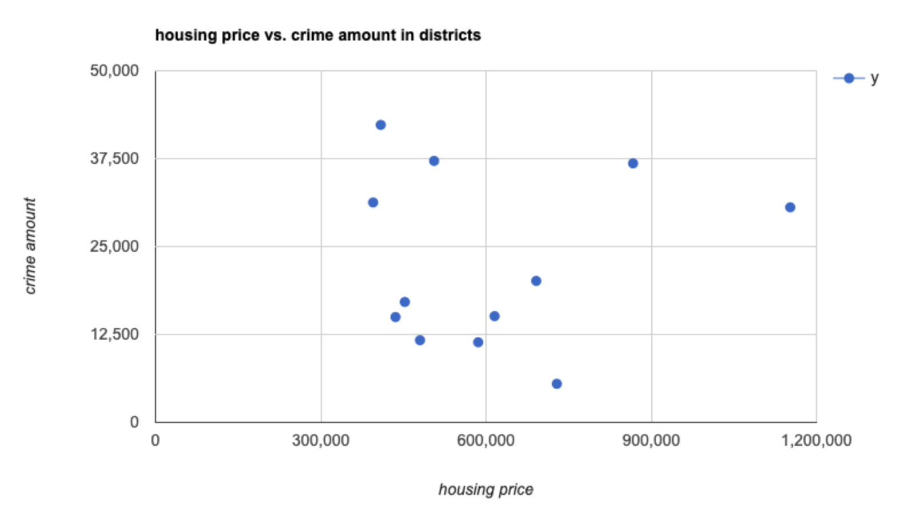
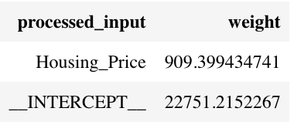
Locate Crimes -- vs. Housing Prices
R-square: 0.006

Slide 14
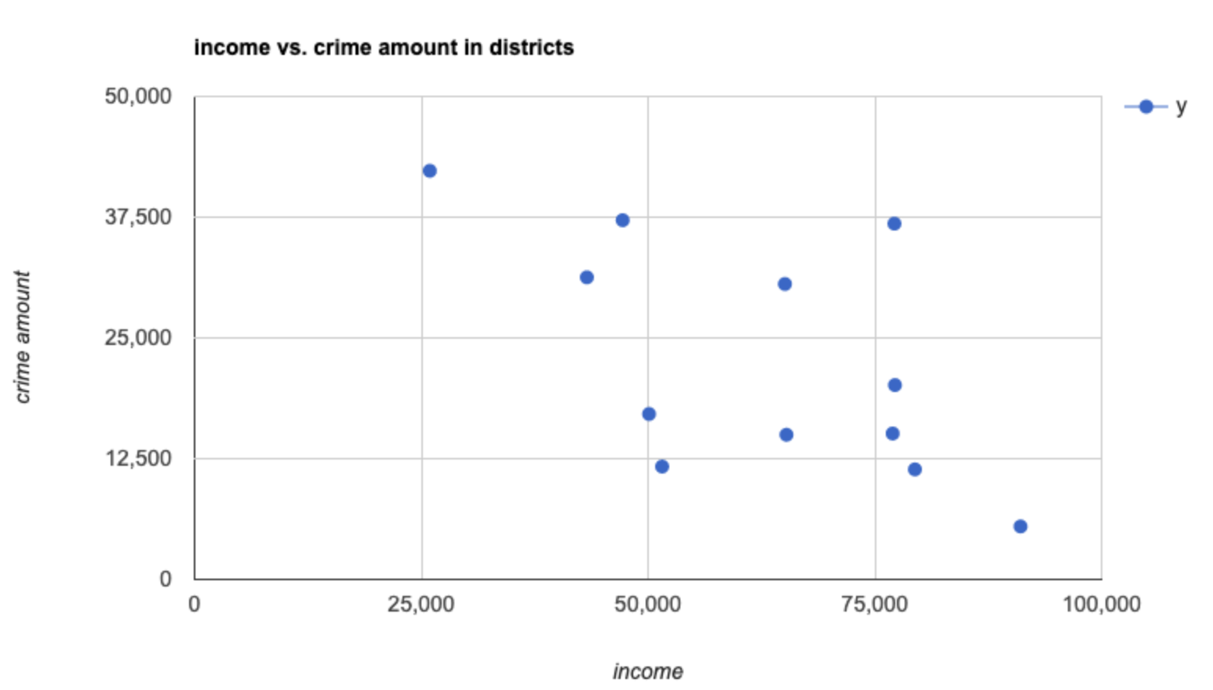
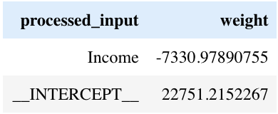
Locate Crimes -- vs. Median Income
R-square: 0.365

Slide 15
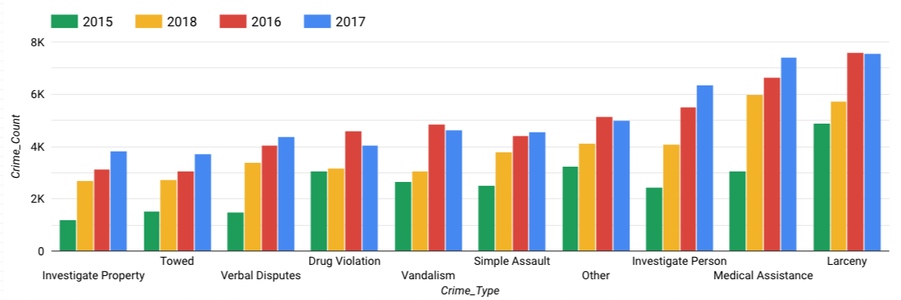
Crime Attribute Analysis -- Crime Type
What is the most common crime in Boston?
Most common type of crime is larceny over the 4 years, with over 25k reported occurrences.
2018 experienced a significant decrease in crime in comparison to 2017 in all categories.
Notes:
%%bq query
SELECT Crime_Type, count(Crime_Type) as CrimeFrequency
FROM Boston_Crime.boston
Group by Crime_Type
Order by CrimeFrequency DESC
LIMIT 3;

Slide 16
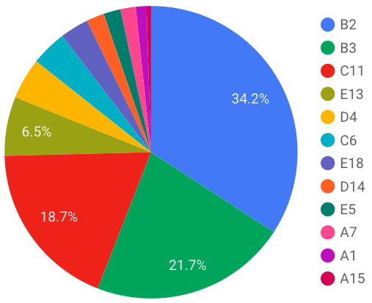
Crime Attribute Analysis -- Shooting
Specifically analyzed shootings in the Boston Area.
Total reported shootings over 4 years: 1012.
Almost three forth Shooting happened in B2(Roxbury ), B3(Mattapan), and C11(Dorchester)
Notes:
%%bq query
SELECT COUNT(shooting) AS TotalShootingOffense
FROM Boston_Crime.boston
Where shooting = 1
Per month
%%bq query -n shooting_in_month
SELECT TIMESTAMP(CONCAT(CAST(EXTRACT(year from OCCURRED_ON_DATE) AS STRING), "-", CAST(EXTRACT(month from OCCURRED_ON_DATE) AS STRING), "-01")) year_month, count(shooting) as shooting_in_month_base
FROM Boston_Crime.boston
WHERE SHOOTING = 1
GROUP BY year_month
ORDER BY year_month;
Graph
%%chart line --d shooting_in_month
title: shooting in a month base
height: 400
width: 1000
hAxis:
title: Time
vAxis:
title: Shooting Count

Slide 17
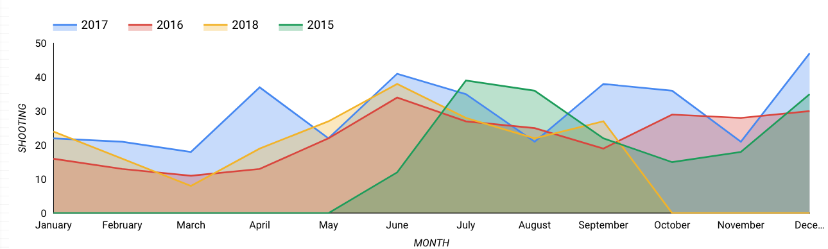
Most dangerous months?
The months June & July had the highest recorded shooting occurrences over the four years.
2017 had the most consistent shooting occurrences on a month by month basis.

Slide 18
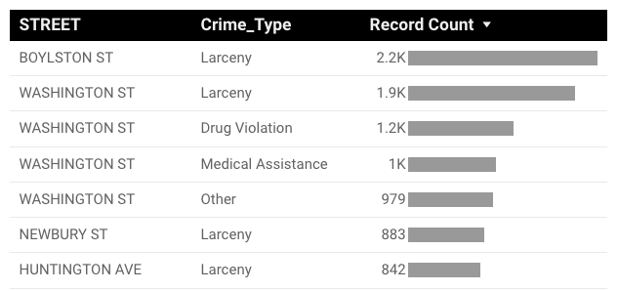
Multivariate Analysis
Location & Crime Type
As noted, larceny was the most common type of crime.
It occurs most often in Boylston & Washington St.
Notes:
%%bq query
SELECT Street, Crime_Type, count(INCIDENT_NUMBER) as numcrime
FROM Boston_Crime.boston
Group by street,Crime_Type
Order by numcrime DESC
LIMIT 10

Slide 19
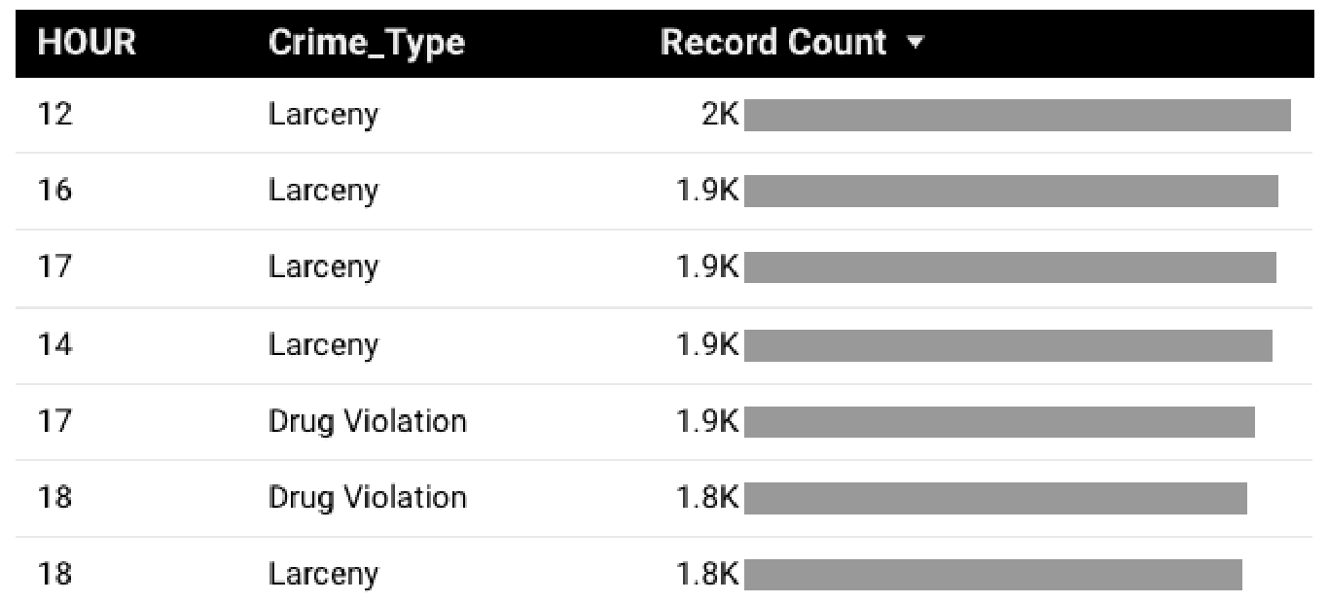
Multivariate Analysis 2
Crime Type & Time
Once again, larceny was the most common type of crime.
Larceny occurs most often in the afternoon, between 12 - 5 pm.
Notes:
%%bq query
SELECT hour,Crime_Type, count(INCIDENT_NUMBER) as numcrime
FROM Boston_Crime.boston
Group by hour,Crime_Type
Order by numcrime DESC
LIMIT 10

Slide 20
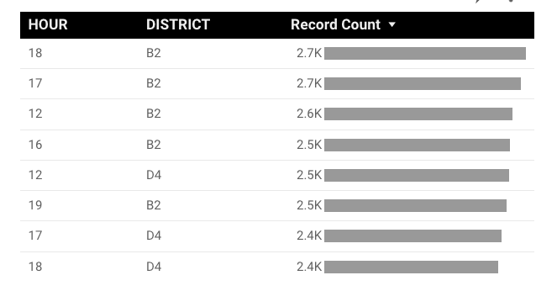
Multivariate Analysis 3
Time & Location
District B2 (Roxbury) is the most dangerous in the Boston area.
Specifically, most dangerous in the evening between 4 - 6 pm.
Notes:
%%bq query
SELECT hour,DISTRICT, count(INCIDENT_NUMBER) as numcrime
FROM Boston_Crime.boston
Group by hour,DISTRICT
Order by numcrime DESC
LIMIT 10

Slide 21
Limitations
Crime Dataset only for 4 years
Administration
Average Housing Prices & Average Median Incomes
Over 10 years
Other factors that affect crime
Eg.) School, hospitals, police station
Notes:
Our data set only includes the past four years, which may give limitations to understanding the underlying nature of crime in the Boston area
The administration could be an example of the rise in crime in the Boston area. Given Massachusetts is a democratic state, opposition to the administration and their macroeconomic policies could explain the rise in crime.
We use average housing prices and average median incomes for regression analysis.

Slide 22


Business Plan

Slide 23
Summary
Based on our analysis above, Boston is a safe city in general. The most frequent crimes are Larceny. Crimes are more likely to happen on Washington St., the longest street in Boston, as well as in Roxbury. Most crimes happen during 4pm to 7pm. Housing prices doesn’t has a statistically significant effect on crimes, but income has partial significance to crimes.
Hope our project will help you survive in Boston!!!

Slide 24
Sources
Crime Data Source:
https://www.kaggle.com/ankkur13/boston-crime-data
Housing Data Source:
https://www.zillow.com/boston-ma/home-values/
Income Data Source:
https://statisticalatlas.com/county-subdivision/Massachusetts/Suffolk-County/Boston/Household-Income
Districts Data Source:
https://bpdnews.com/districts

Slide 25

Dashboard
https://datastudio.google.com/open/1GCwkYrQMg6IZx3y7T_DKf4ZxcF8dPgWH
Questions?
Yours
Answers!
Ours

Slide 26


